Slide 1
Java Swing Tutorial

Slide 2
Introduction
Swing – A set of GUI classes
  Part of the Java's standard library
  Much better than the previous library: AWT
    Abstract Window Toolkit
Highlights
  A rich set of widgets
    Widget: Any GUI element (also called: components)
  Contents and shape are separated (MVC support)‏
  Fine-grained control over the behavior and look and feel
  Platform independent
    Isolates the programmer from the operating system's GUI

Slide 3
Swing Components
Containers
  Contain and manage other components.
  Top Level/Internal
  Examples: JFrame (Top Level), JScrollPane, JPanel.
Basic controls
  Atomic components
  Used for showing ouput and/or getting some input
  Inherits JComponent
  Examples: JButton, JLabel, JTextArea, JTable, Jlist
Usually every Swing class extends the corresponding AWT class
  For backward-compatibility reasons

Slide 4
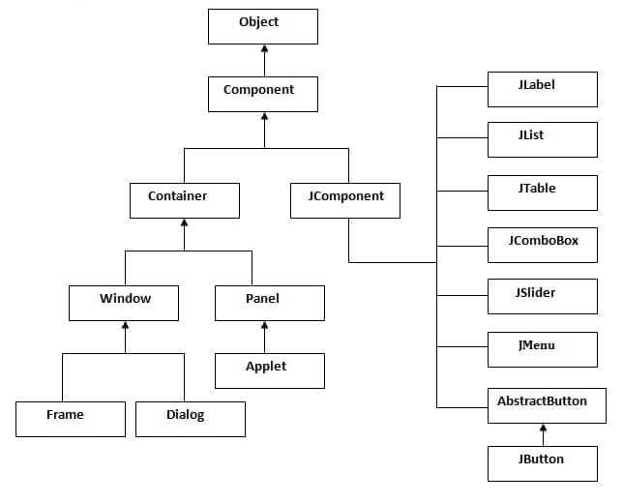
Swing Components Hierarchy

Slide 5

My First Swing Program
import javax.swing.*;
import java.awt.BorderLayout;
public class First {
public static void main(String[] args) {
JFrame frame = new JFrame("My First Frame");
// operation to do when the window is closed.
frame.setDefaultCloseOperation(JFrame.EXIT_ON_CLOSE);
frame.getContentPane().setLayout(new BorderLayout());
frame.getContentPane().add(new JLabel("I Love Swing"),
BorderLayout.CENTER);
frame.pack();
frame.setVisible(true);
}
}

Slide 6
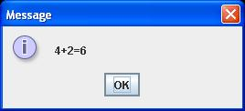
Top Level Containers: JDialog
javax.swing.JDialog:
  More simple and limited than frames
  Typically used for showing a short message on the screen
  Also has a border and a title bar
  May have an owner
    If the owner is invisible the dialog will also be invisible
  Use the static method of JoptionPane to show standard dialog boxes:
  JOptionPane.showMessageDialog(null, "4+2=6");

Slide 7
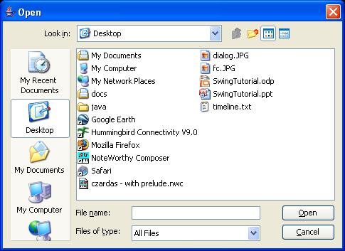
Top Level Containers: JFileChooser
javax.swing.JFileChooser:
  Allows the the user to choose a file
  Supports “open” and “save”: showOpenDialog(),showSaveDialog()‏
JFileChooser fc = new JFileChooser();
int returnVal = fc.showOpenDialog(null);
if(returnVal == JFileChooser.APPROVE_OPTION)
System.out.println("File: " + fc.getSelectedFile());

Slide 8
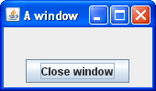
Top Level Containers: JFrame
javax.swing.JFrame:
  Top-level window with a title and a border.
  Usually used as a program's main window

Slide 9
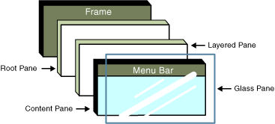
More on JFrame
Made of several layers
Widgets are added to the Content Pane layer.
  Use getContentPane() to obtain it
Other layers are used for customizing the window's appearence

Slide 10
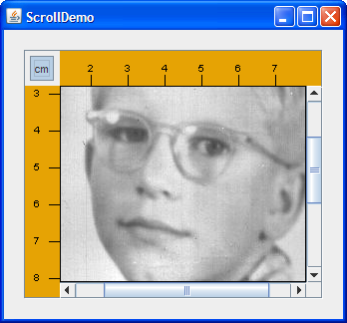
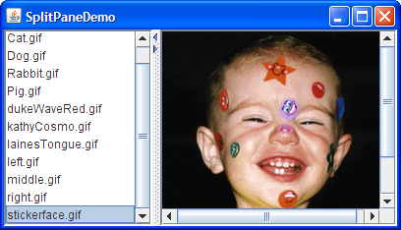
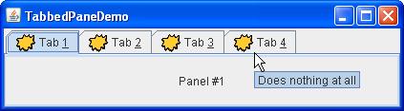
Internal Containers
Not Top level containers
Can contain other non-top level components
Examples:
  JScrollPane: Provides a scrollable view of its
  components
  JSplitPane: Separates two components
  JTabbedPane: User chooses which
  component to see

Slide 11
Containers - Layout
Each container has a layout manager
  Determines the size, location of contained widgets.
Setting the current layout of a container:
void setLayout(LayoutManager lm)
LayoutManager implementing classes:
  BorderLayout
  BoxLayout
  FlowLayout
  GridLayout

Slide 12
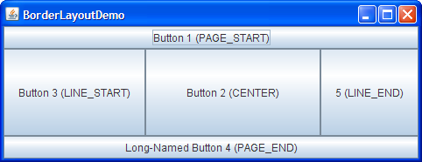
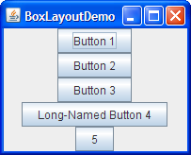
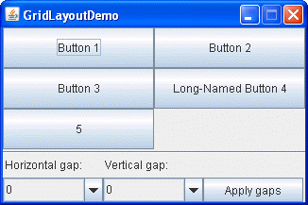

Containers - Layout

Slide 13
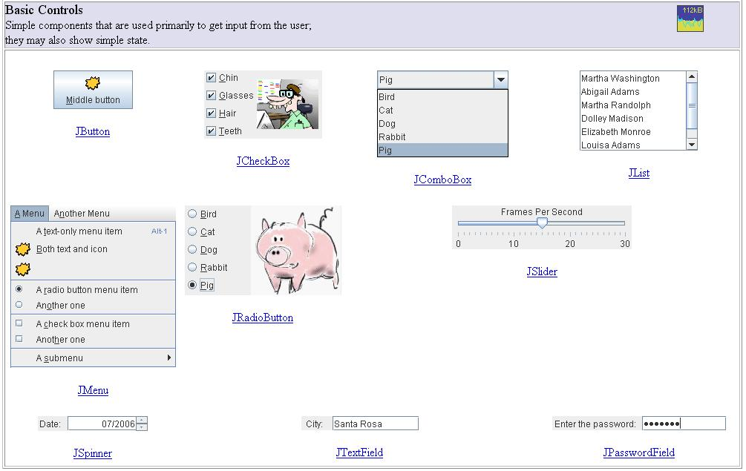
Swing Components

Slide 14
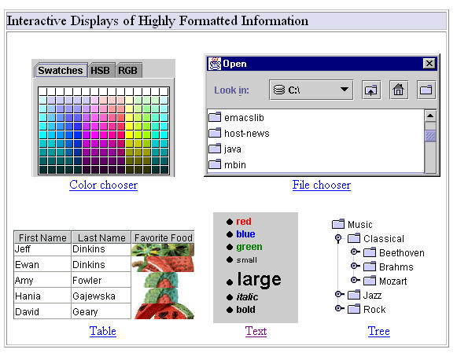
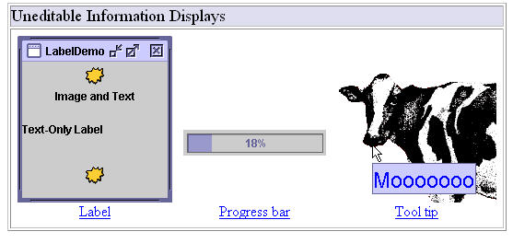
Swing Components

Slide 15
First Swing Program Revisited
Create a frame
import javax.swing.*;
import java.awt.BorderLayout;
public class First {
public static void main(String[] args) {
JFrame frame = new JFrame("My First Frame");
// operation to do when the window is closed.
frame.setDefaultCloseOperation(JFrame.EXIT_ON_CLOSE);
frame.getContentPane().setLayout(new BorderLayout());
frame.getContentPane().add(new JLabel("I Love Swing"),
BorderLayout.CENTER);
frame.pack();
frame.setVisible(true);
}
}
Choose the border layout
Create a text label
Add the label to the content pane
Specify CENTER as the layout position

Slide 16
Input
So we now know how to present widgets on the screen
A program also needs to react to the user's actions
Examples:
  When the user presses a button we want to save a file
  When the user closes the program we want to ask “are you sure?”
  ...
Swing mechanism: Events and Listeners

Slide 17
Events, Listeners
Swing defines all sorts of Listener interfaces
  E.g.: ActionListener, MouseMotionListener,
  WindowListener, ...
public interface ActionListener extends EventListener {
public void actionPerformed(ActionEvent e);
}
public interface MouseMotionListener extends EventListener {
public void mouseDragged(MouseEvent e);
public void mouseMoved(MouseEvent e);
}
There are default (empty) implementations for many of the listeners
  E.g.: MouseMotionAdapter, WindowAdapter

Slide 18
Events, Listeners (cont.)‏
A listener is an object that implements a listener interface
If we need to react to an event (on a certain widget) we register a listener object with that widget
E.g.: addActionListener() registers an action listener with its receiver:
JButton button = new JButton();
ActionListener listener = ...;
button.addActionListener(listener);
When an event occurs, all registered listeners are notified
  The appropriate listener method (e.g: actionPerformed()) is invoked
  An object describing the event is passed as a parameter

Slide 19
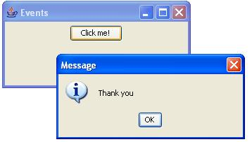
Event Handling Demo: GUI

Slide 20
Event Handling Demo: Code
import javax.swing.*;
import java.awt.*;
import java.awt.event.*;
public class Events implements ActionListener {
public Events() {
JFrame frame = new JFrame("Events");
frame.setDefaultCloseOperation(JFrame.EXIT_ON_CLOSE);
frame.getContentPane().setLayout(new FlowLayout());
JButton b = new JButton("Click me!");
b.addActionListener(this);
frame.getContentPane().add(b);
frame.pack();
frame.setVisible(true);
}
public void actionPerformed(ActionEvent e) {
JOptionPane.showMessageDialog(null, "Thank you");
}
public static void main(String[] args) { new Events(); }
}

Slide 21
Inner Classes
Nested within another classes
Instance specific:
  Has access to methods & fields of the object that created it
  => An inner class has TWO this variables
Can be static
  Can access only static members and methods only
  A static method cannot create a non-static inner class

Slide 22
Local Classes
Same as inner classes but defined inside a method
Has access to local variables of the enclosing method
  Only if the variable is defined as final
Can be anonymous
  Doesn’t have a name.

Slide 23
Event Handling Demo: Local Class
import javax.swing.*;
import java.awt.*;
import java.awt.event.*;
public class Events {
public Events() {
JFrame frame = new JFrame("Events");
frame.setDefaultCloseOperation(JFrame.EXIT_ON_CLOSE);
frame.getContentPane().setLayout(new FlowLayout());
JButton b = new JButton("Click me!");
b.addActionListener(new ActionListener() {
public void actionPerformed(ActionEvent e) {
JOptionPane.showMessageDialog(null, "Thank you");
}
});
frame.getContentPane().add(b);
frame.pack();
frame.setVisible(true);
}
public static void main(String[] args) { new Events(); }
}

Slide 24
Swing's JTable
Each JTable has a TableModel object that holds the data shown by the table.
DefaultTableModel is a default implementation of TableModel
  By default it makes all the cells editable
We can customize its behavior by subclassing
  Or we can implement TableModel from scratch
TableModelListener - a listener interface
  Notified of changes in the model
Use TableModel.addTableModelListener() to register a listener object

